Slide 1
A network analysis of
Actors/Directors and Movies
Simrat Benipal, Jose Perales, Ishrat Naba
Group # 11
Netflix II
Notes:
Jose

Slide 2

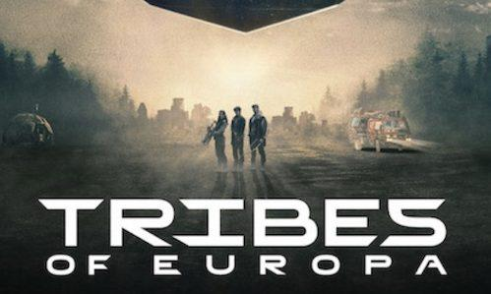


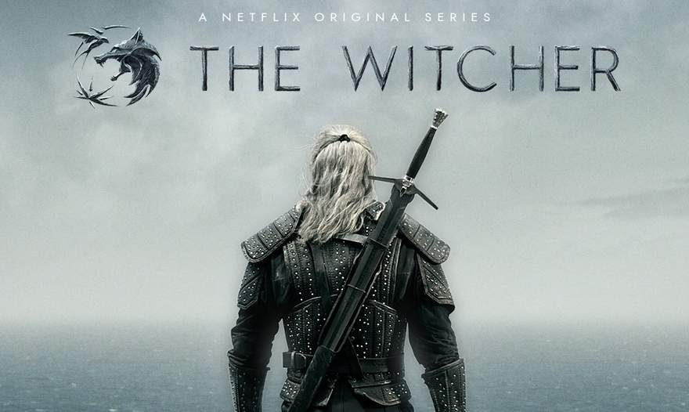

Research Questions
Can distinct communities be identified within the Netflix movie network, and if so, what characteristics define them?
Who are the key individuals within the Netflix movie network, and how do they facilitate connections between different communities?
Notes:
Jose
By answering these questions, we will be able to assist large streaming platforms (more largely Netflix) create more cross-collaboration between actors across the network as well as help them offer more diverse content that is tailored to the tastes of audiences in different locations.

Slide 3
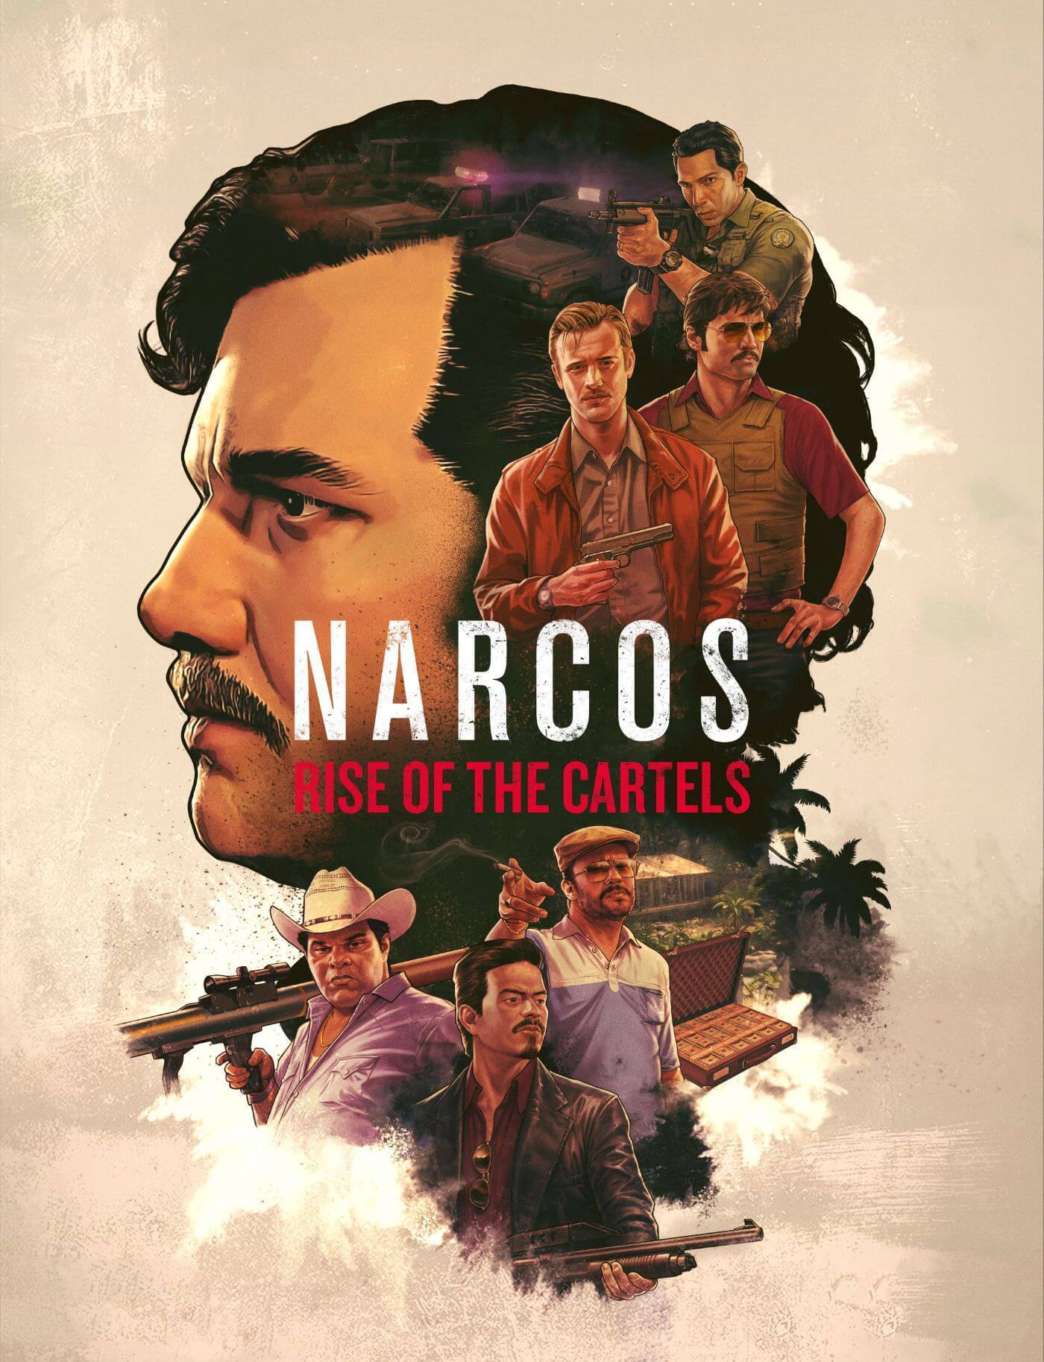



Network
Nodes: Movies and People (Cast, Directors) involved in the filmmaking.
Edges: Denote various interactions in the movie-making process.
Cast ←> Movie, if cast members appeared in the movie.
Directors ↔ Movies, if director directed the movie.
Directors ↔ Cast, if director and cast worked together.
NARCOS
ARCANE
COWBOY BEBOP
LUCIFER
Notes:
Simrat
In the network, nodes are represented by movie, cast members involved in it and directors who directed the movie
links/edges represents the various interactions in the movie making process
Our network had three types of edges
Edge between Cast and movies representing the cast members that appeared in the movie
Edge between Directors and movies, representing the directors who directed the movie
Edge between Directors and cast, if they have worked together

Slide 4
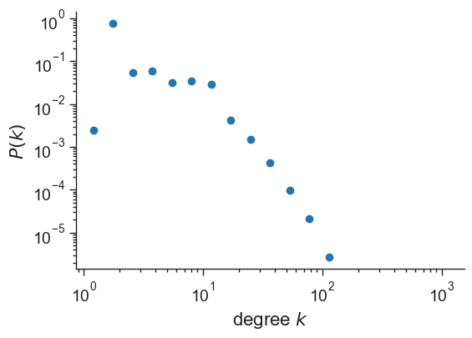
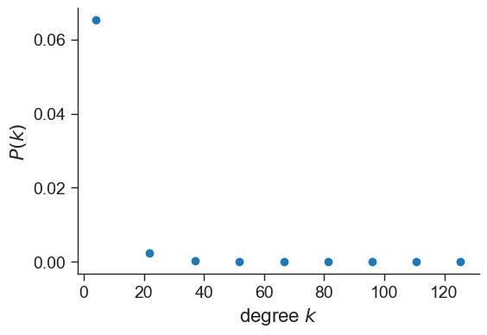
Network Statistics
Nodes: 35,133. Edges: 95,500.
Connected components: 512
Min Degree: 1, Max Degree: 133
Average degree per type:
Movies: Average degree of 8.28
shows collaborative network
Directors: Average degree of 10.99
central role in industry due to high number of connections
Cast members: Average degree of 3.63
less connected than directors
Notes:
Simrat
Some of the statistics for our network
Total number of nodes were around 35,000 and total number of edges were around 95,500
Total connected components were equal to 512
Degree of nodes ranged from 1 to highest 133
The average degree for movies were 8.28 reflecting the collaborative nature of 8 actors and directors per film
The average degree of directors were 10.99 which shows the central role in the industry due to larger number of connections
The average degree of cast members of 3.63 which shows that actors are less connected than directors.

Slide 5
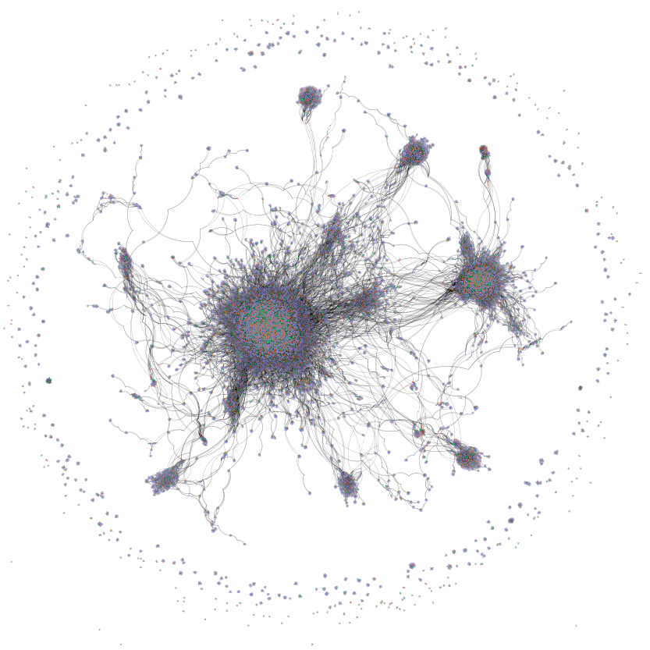
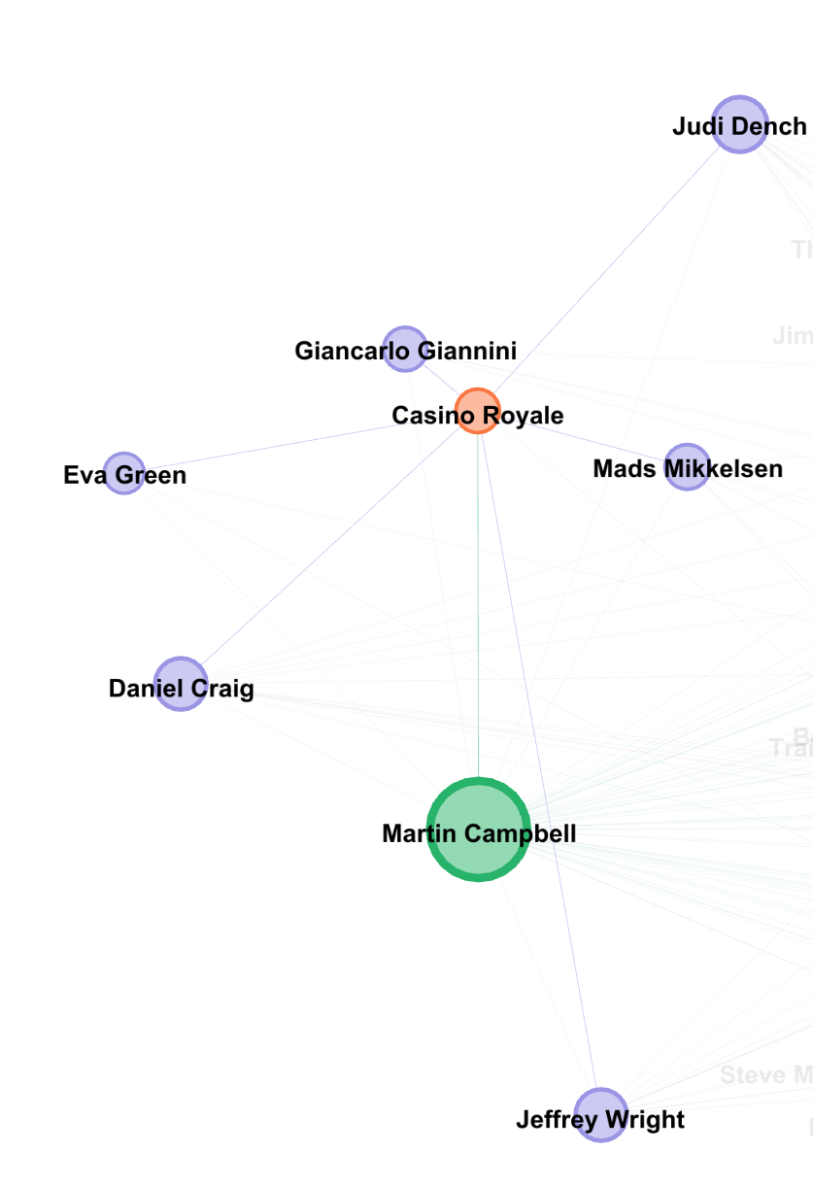
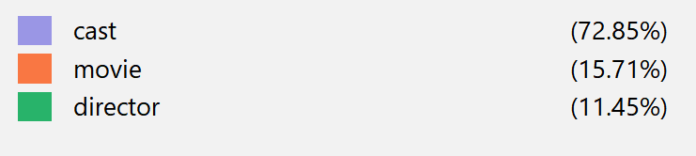
Visualizations
Notes:
Simrat
The following is the visualisation of our network
Every movie is represented by orange node
Every director is represented by green node
And all the cast members are represented by violet node
The size of the node represents the degree of a node. Higher the degree, bigger the node is.
As seen on the right, we had some isolate sub networks and one giant connected component in the network

Slide 6
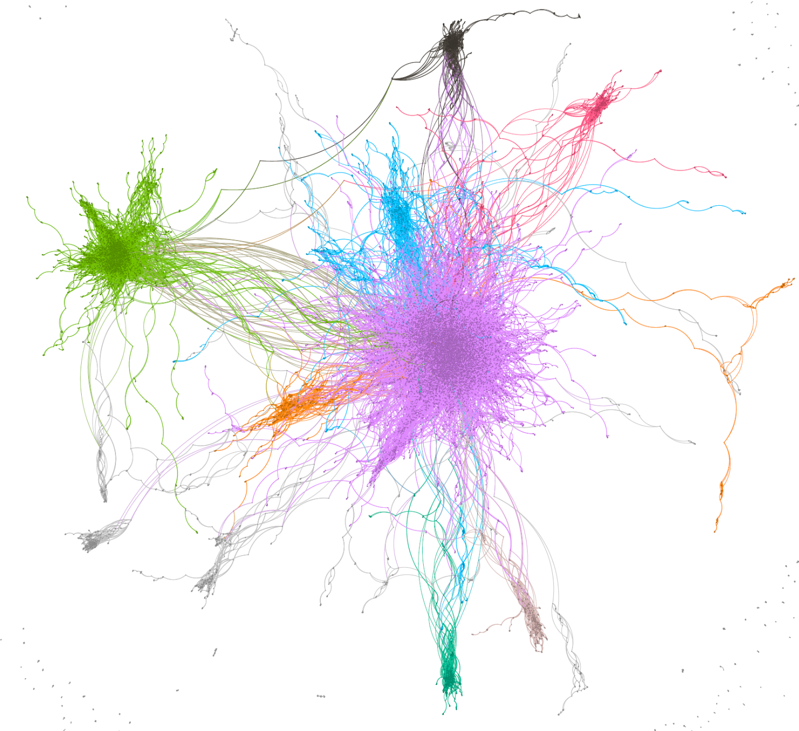
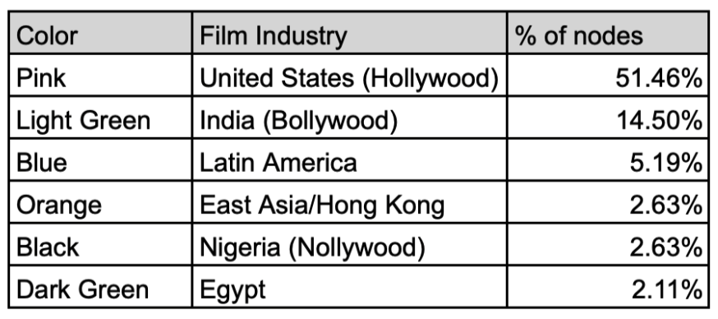
Detecting Communities
Avg Modularity: 0.8351
Used Louvain Method.
Each color can be mapped to a distinct film industry.
6 prominent communities.
Notes:
Jose
Biggest: American (Hollywood)
2nd biggest: India (Bollywood)
Louvian method maximizes modularity value.
Highest betweenness centrality measure → bridge node and more interaction takes places during communication.

Slide 7
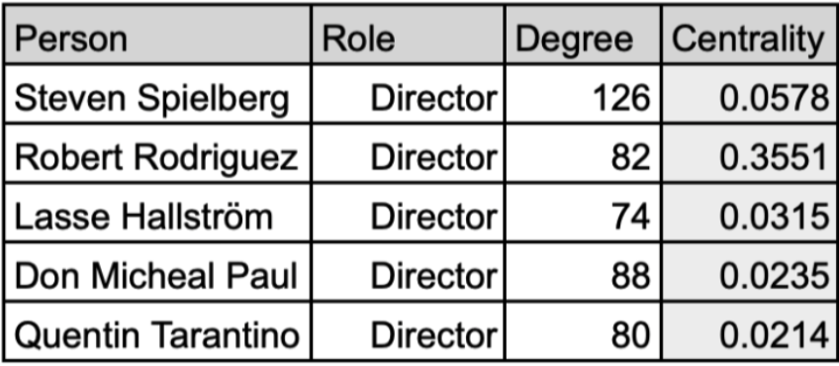
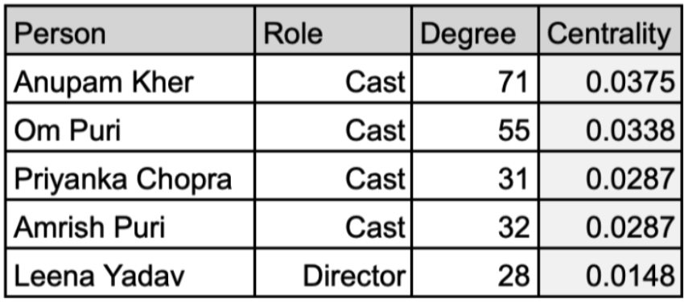
Identifying Key Individuals
Measure by highest betweenness centrality.
Higher degree does not equate to higher centrality.
Centrality relates to a node’s potential to connect different communities.
Examples of notable bridge nodes identified:
Anupam Kher
Om Puri
American film industry
Indian film industry

Slide 8
Null Model Analysis
Ten configuration null models.
Clustering observed is far from random, likely driven by other factors.
Higher average path length than null model.
Structural constraints (geographic distribution or language barriers)
Preferential attachment creating hubs
Clustering leading to longer cross-cluster paths
Network | Clustering Coefficient | Avg. Path Length
Netflix network | 0.6482 | 8.65
Null Model | 0.00072 | 5.24
Notes:
Jose
Ten configuration null models, total run time equal 3+ hours.
Lower clustering coefficient in null model signifies that there is less clustering in the network compared to the actual network
Lower Average path length in null models signifies that the null model is more well-connected as it has fewer steps to reach certain nodes
Structural constraints (geographic distribution, language warriors) may contribute to this
Exclusive networks refer to limited access groups within the network, which can influence collaboration.
Preferential attachment suggests that nodes with higher connectivity attract more connections, leading to the formation of hubs/central nodes in the network.

Slide 9
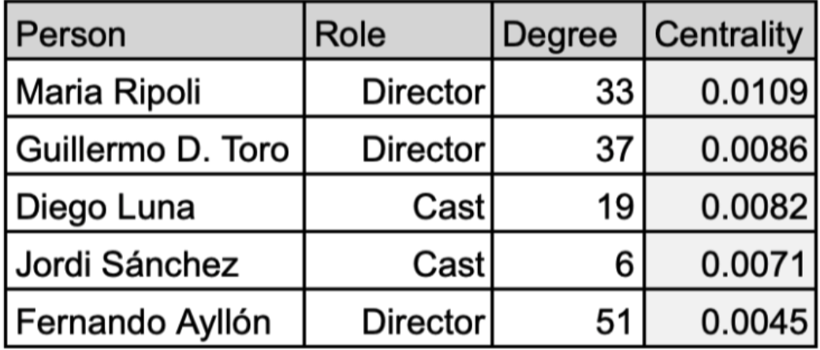
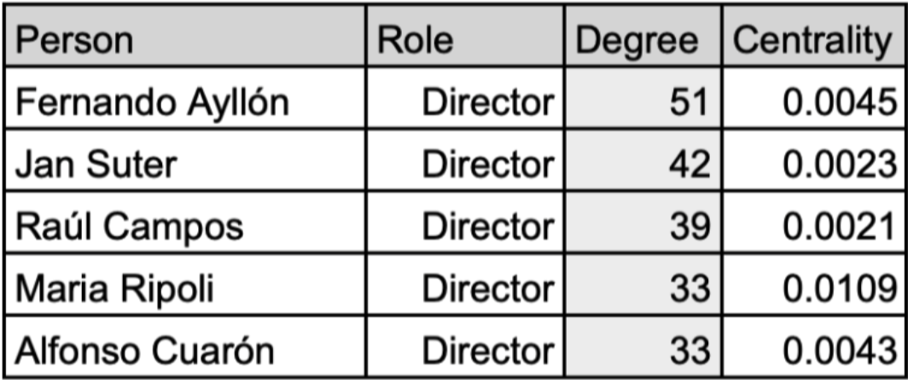
Takeaways
Including individuals with high betweenness centrality could bring wider audiences.
Since higher degree != higher centrality, look for different individuals depending on objective.
Looking to transfer from one film industry to another is different than wanting to expand in the current one.
Important to understand community to which you belong.
Latin America, sorted by centrality
Latin America, sorted by degree
Notes:
that method is used for the community detection in a network, it is at type of greedy algorithm that maximizes the modularity value. (higher modularity, more certain that communities exists). This is the best suited model for network with larger number of nodes. runs in O(n*long(n))

Slide 10
Future Work
Extend analysis to include TV shows and other Netflix content as well.
Extend analysis to other streaming platforms and compare them.
Incorporate more recent data.

Slide 12



REFERENCES
Dataset::https://www.kaggle.com/datasets/shivamb/netflix-shows/data

